Slide 1

Team 4
Project name —— display only

Slide 2


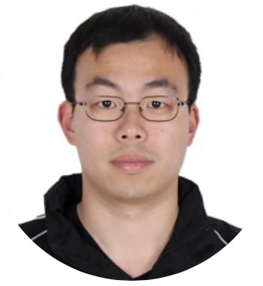



Group Member
Heath Team Leader/ Frontend designer/ Integration
Louie backend designer
Ziqi Frontend Integration
Violet Report Writer/Figma designer
John PPT Writer
Nancy Report Writer/PPT designer

Slide 3

Challenge&Learning Process Coding part

Slide 4
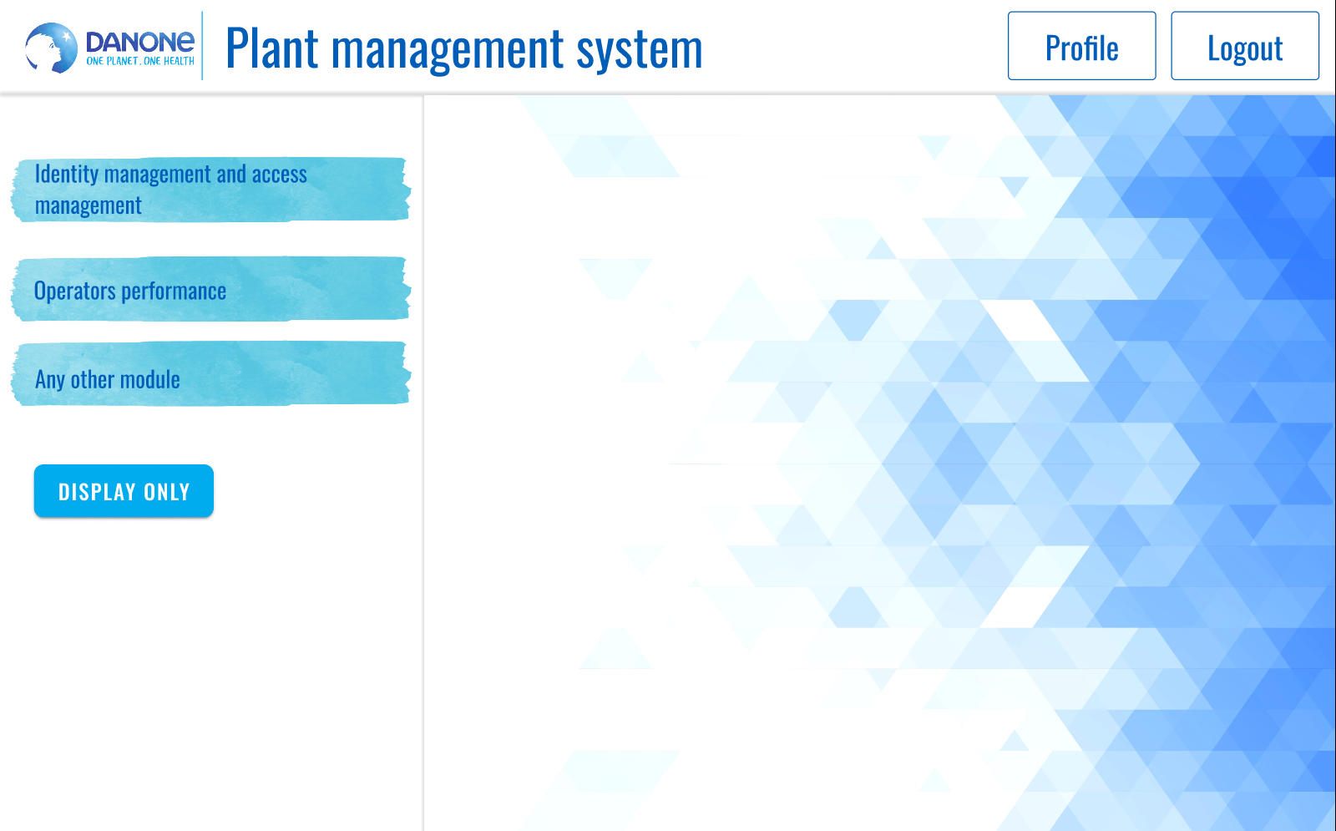
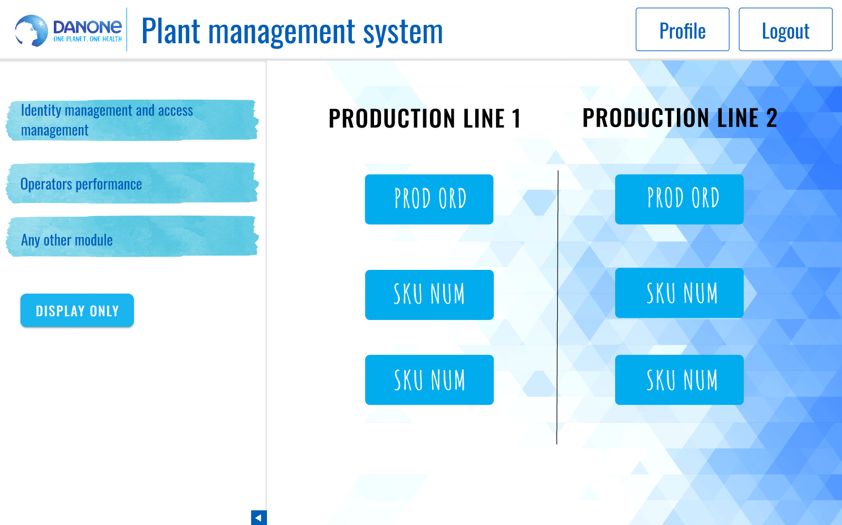
Frontend-Figma
Heath Song

Slide 5
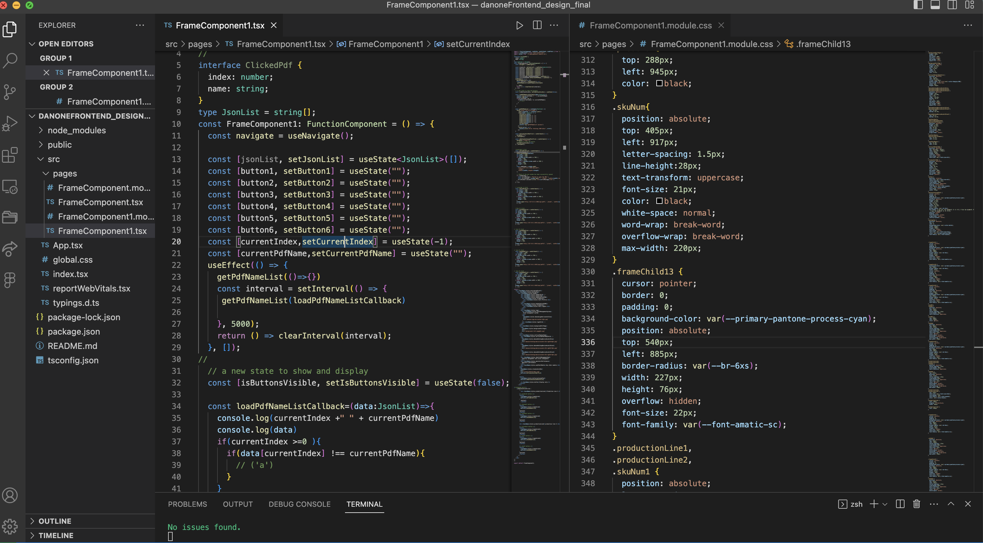
Frontend- frontend structure

Slide 6
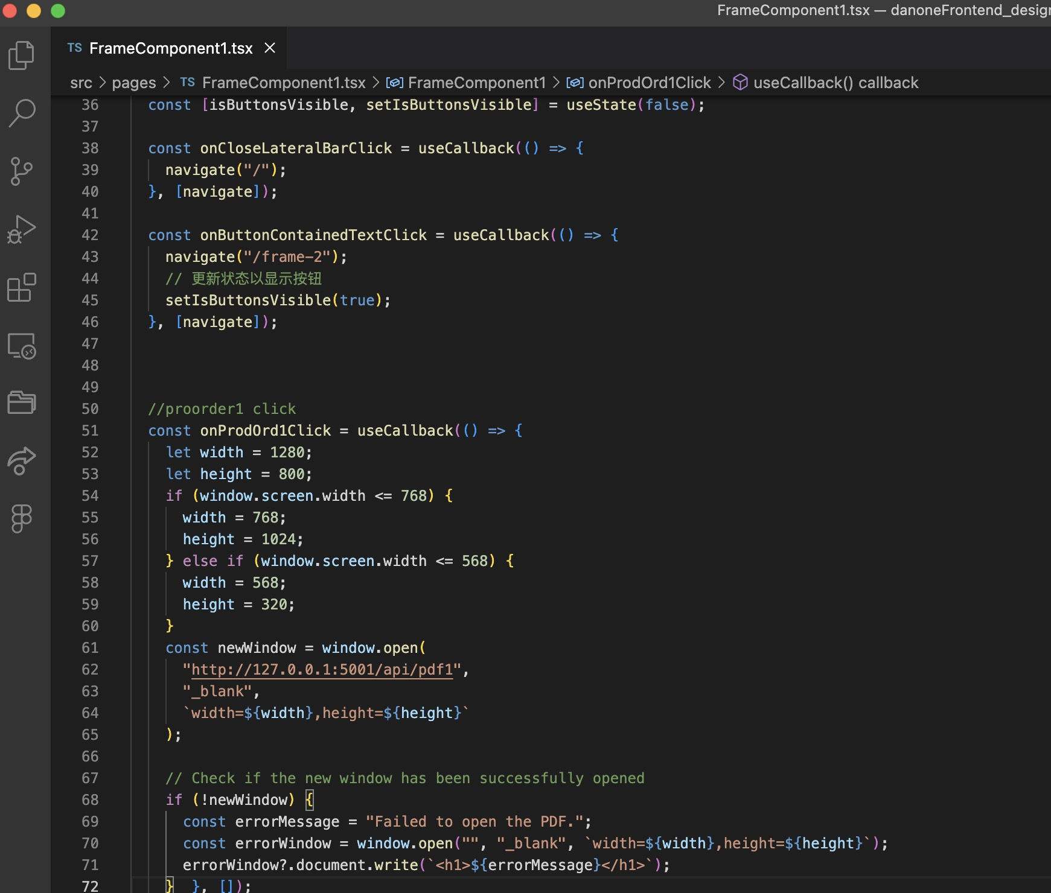
Frontend Integration
Han Ziqi

Slide 7
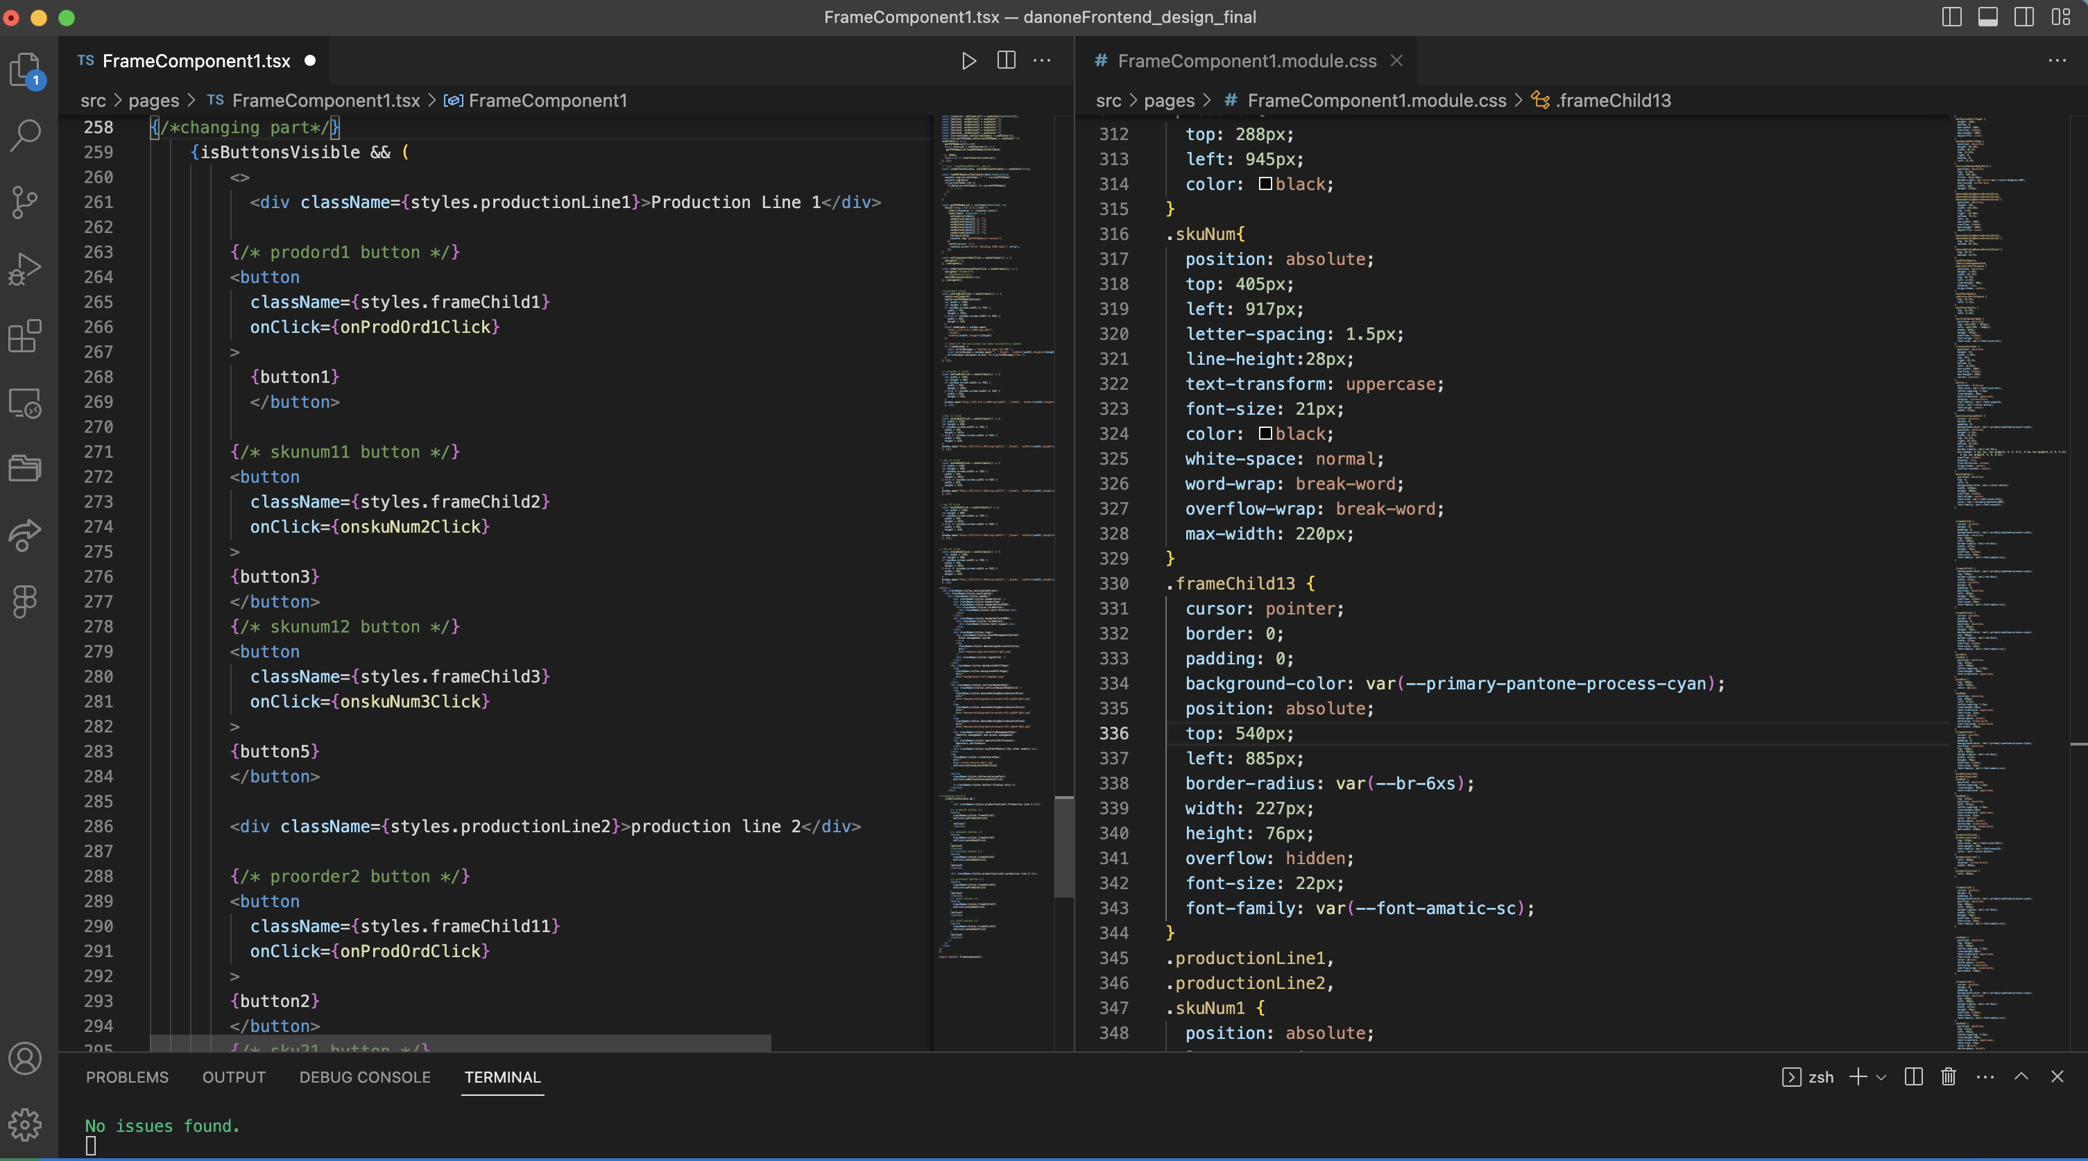

Slide 8
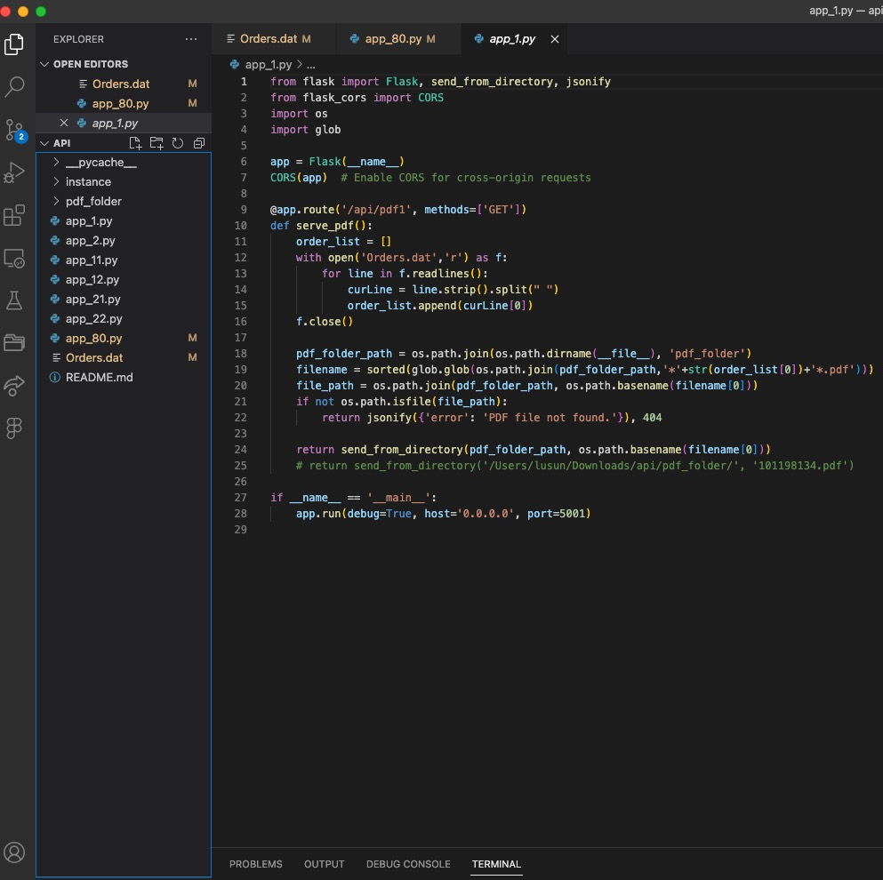
Backend -Louie Sun
Design Flask Framework
Create seven APIs
Using RestAPI to transfer the PDF deom the backend to frontend
Connecting successfully

Slide 9
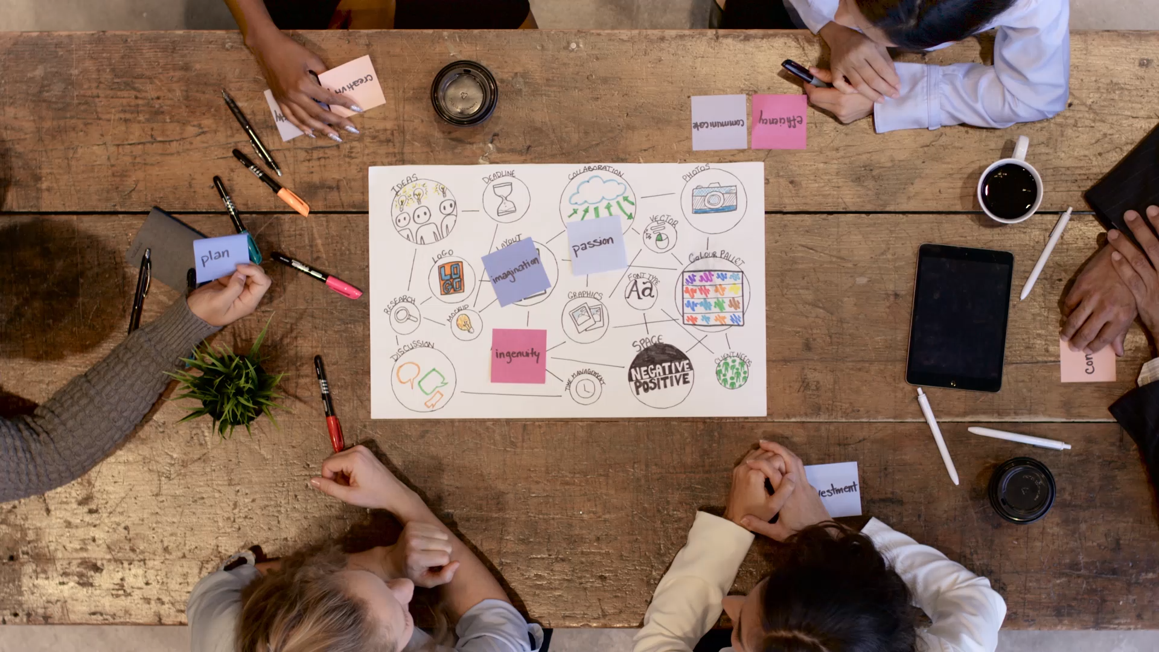
Challenge&Learning Process Designing part

Slide 10

Report ---- Violet Chen
Improved the readability of the paragraphs
Explain the resources required & project targets
“Design Thinking Process” explained in detail
Adding the screenshots

Slide 11
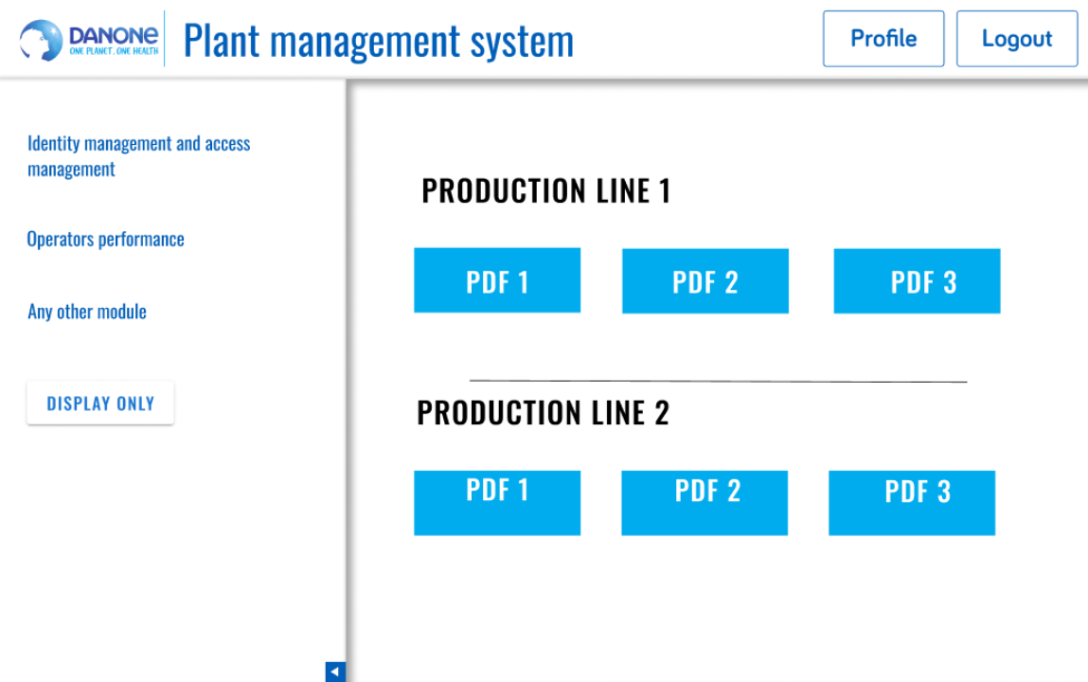
Figma Design
Two different PDF designs
Selected by communicating with the mentor

Slide 12

PPT and app_80 ---- John
Presentation design
Backend design
communication

Slide 13
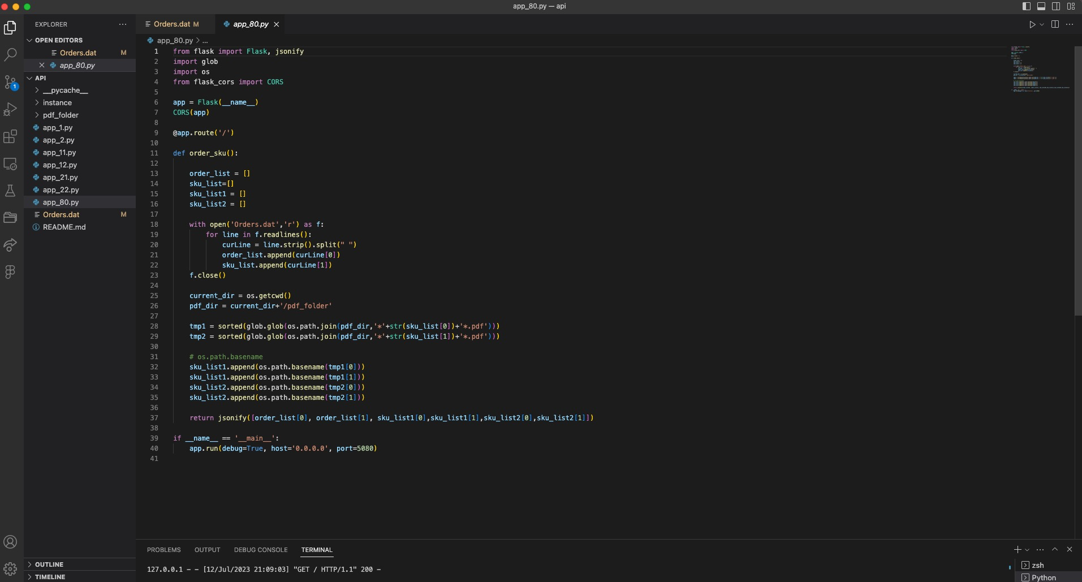
App_80 transfer API port

Slide 14
Report---Nancy
Table of content
ER Diagram
Report structure
Communication
Integration

Slide 15
PPT--- Nancy
Communication
Structure of slides
Integration
Design

Slide 16
Now it's demo time

